Slide 1

Analysis of Data Science Position Salaries and Recommendation
Benjamin Michaels
August 4th, 2023

Slide 2
Information
Company Sizes
Experience Levels
S (Small) = Less than 50 Employees
M (Medium) = 50 to 250 Employees
L (Large) = More than 250 Employees
EN = Entry-Level/Junior
MI = Mid-Level/Intermediate
SE = Senior-Level/Expert
EX = Executive-Level/Director
*All data used are from employees working at a full-time capacity

Slide 3
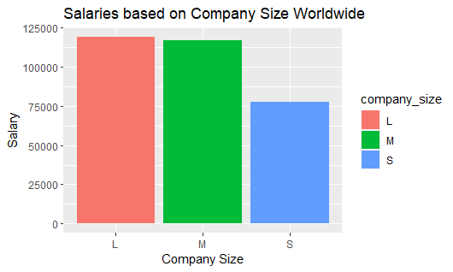
Salaries of Data Science Positions Worldwide

Slide 4
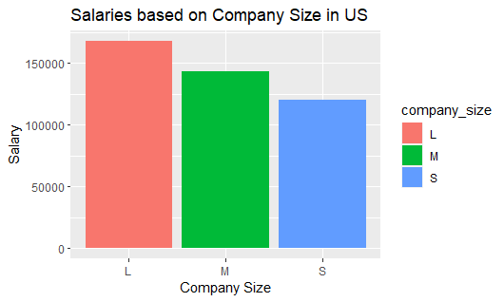
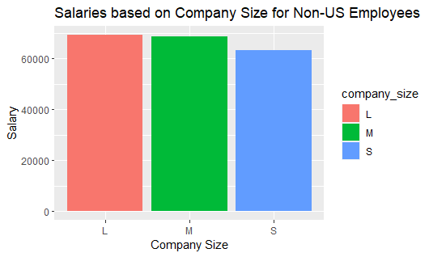
Salaries of Data Science Positions in US and not in US

Slide 5
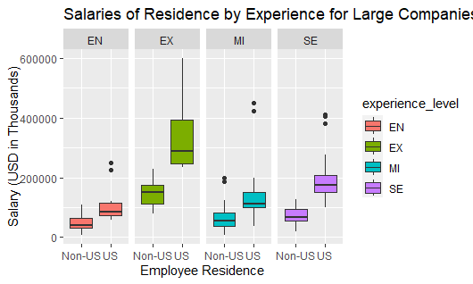
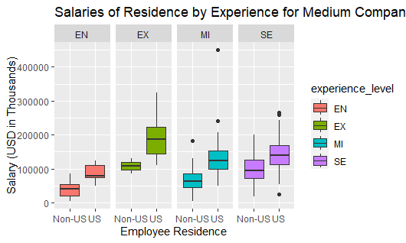
Salaries of US and Non-US Employees by Experience for Large and Medium Companies
*Small companies were excluded from this part of the analysis because as an expanding company I recommend that we look towards larger companies for insight.

Slide 6
Recommendation
To start the building of a team of data scientists the company will need someone to lead said team as well as take on individual technical contributions. Someone who has the ability to not only lead but to mentor and build an effective team that coincides with the growth of the company. Thus, to start the following is what is recommended based on the previously provided data.
Position Title: Staff Data Scientist
Experience Level: Senior
Salary Range: $175,000 to $250,000 based on experience
Experience with a large company or a medium company that has roughly about 175-250 employees

